Slide 1


Slide 2
Compute

Slide 3
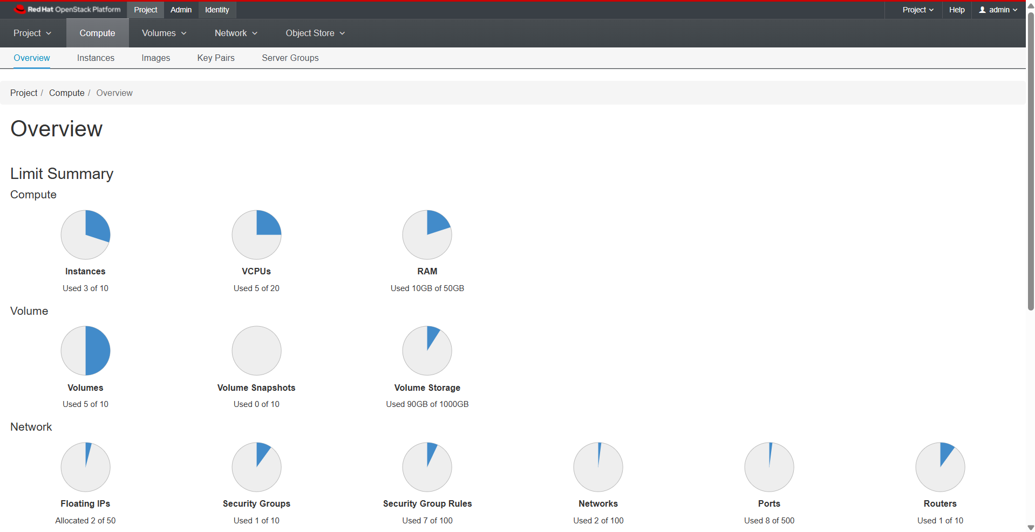
Overview

Slide 4
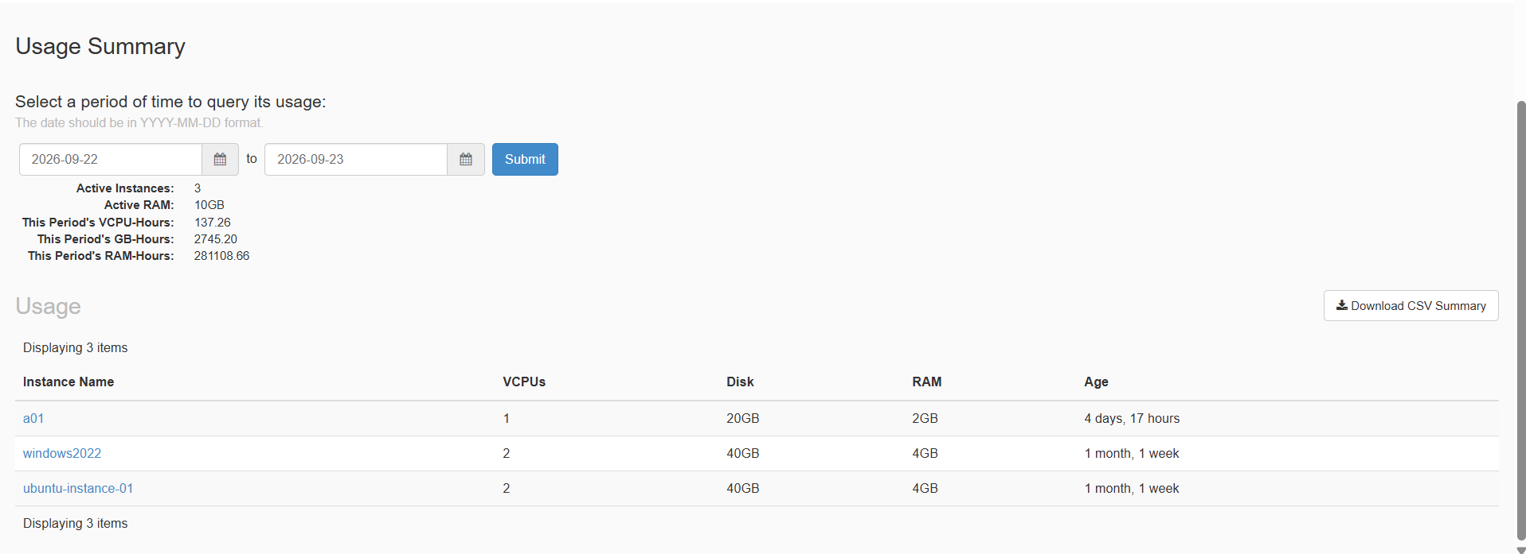
Overview

Slide 5
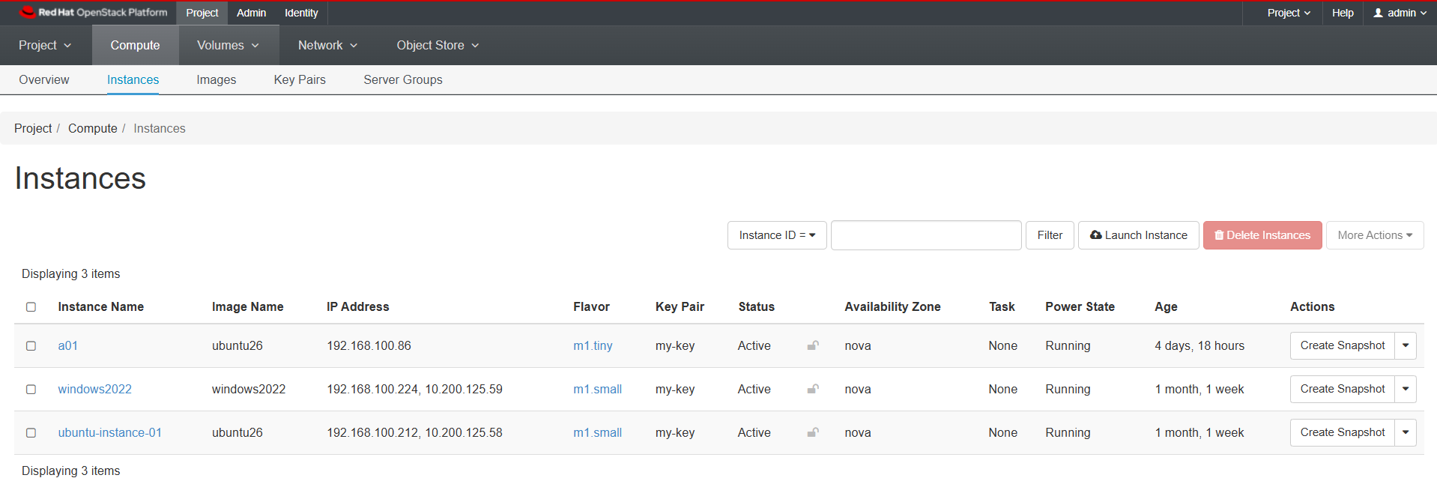
Instances

Slide 6
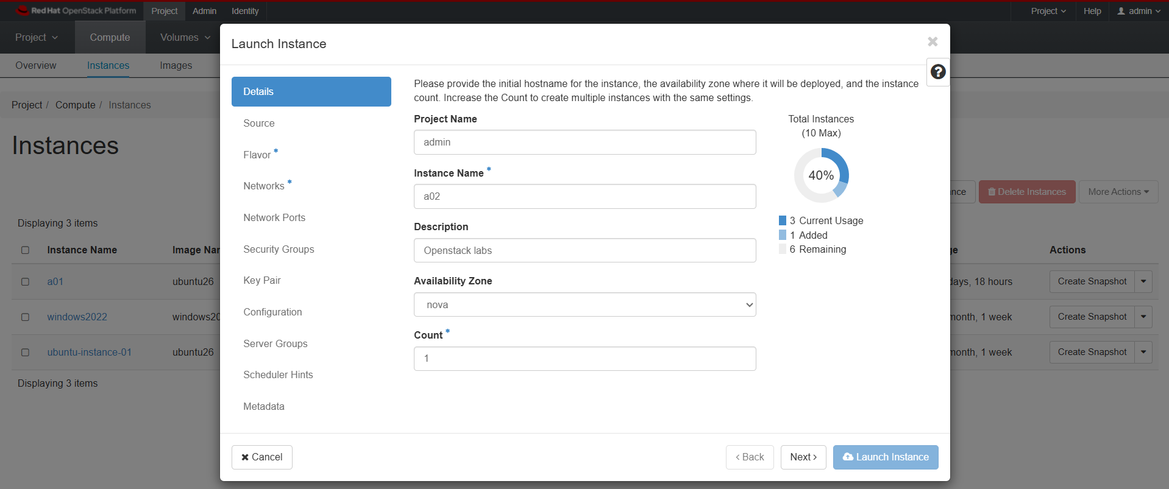
Instances

Slide 7
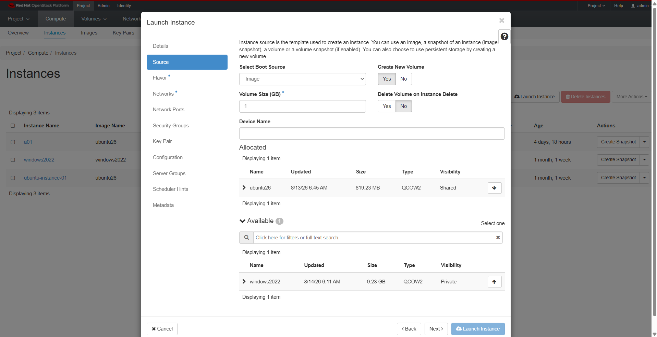
Instances

Slide 8
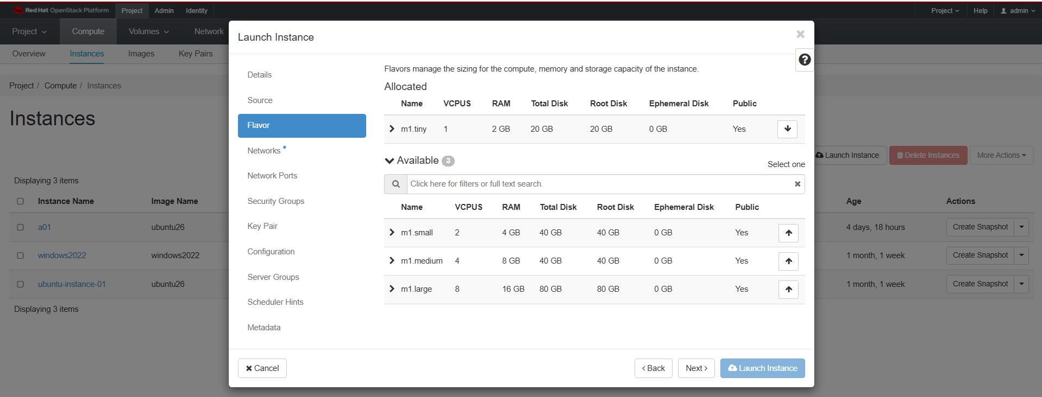
Instances

Slide 9
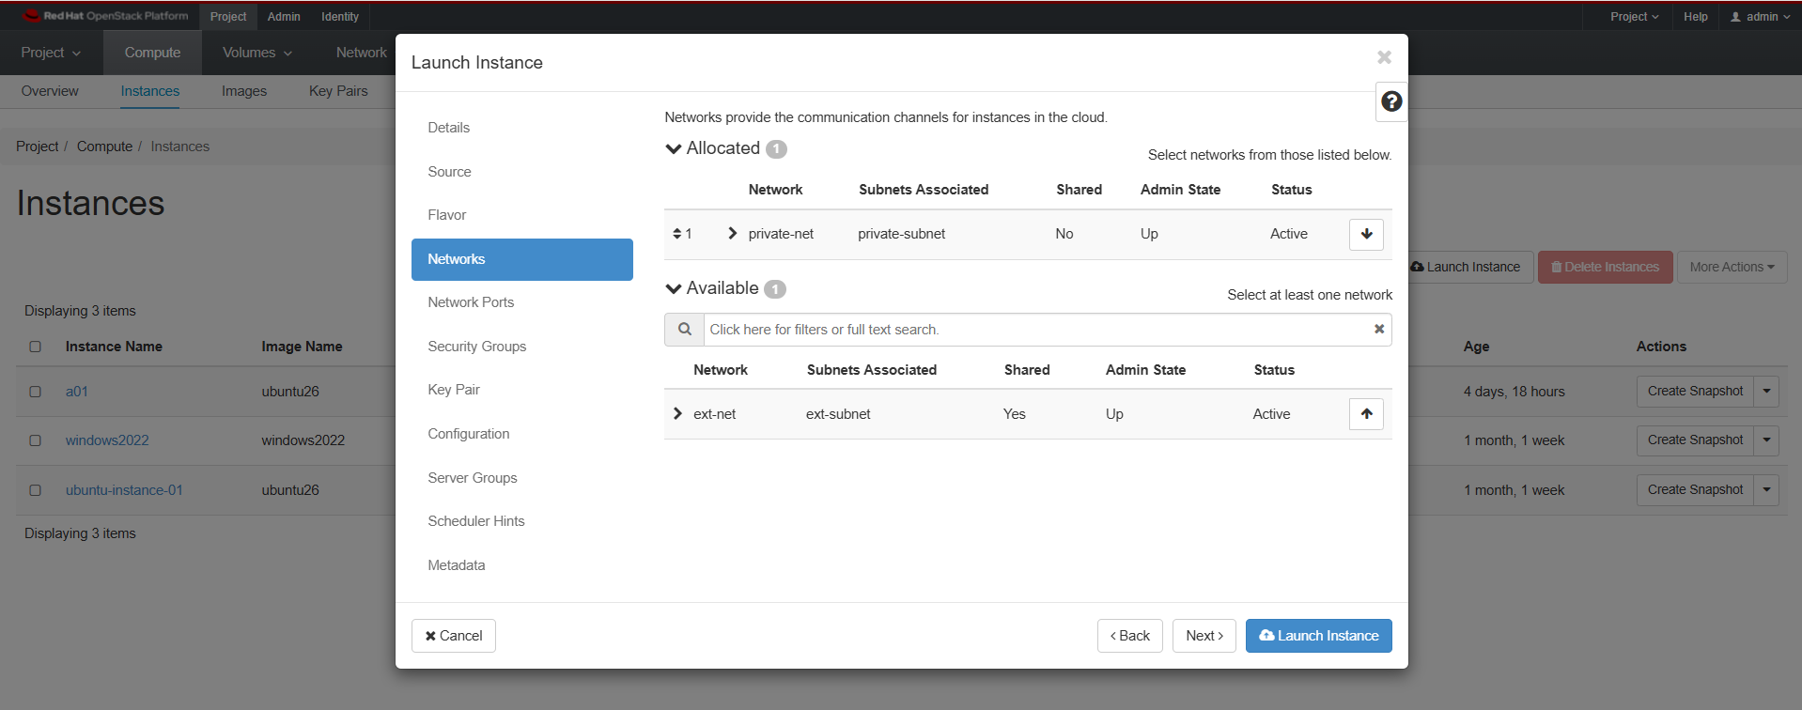
Instances

Slide 10
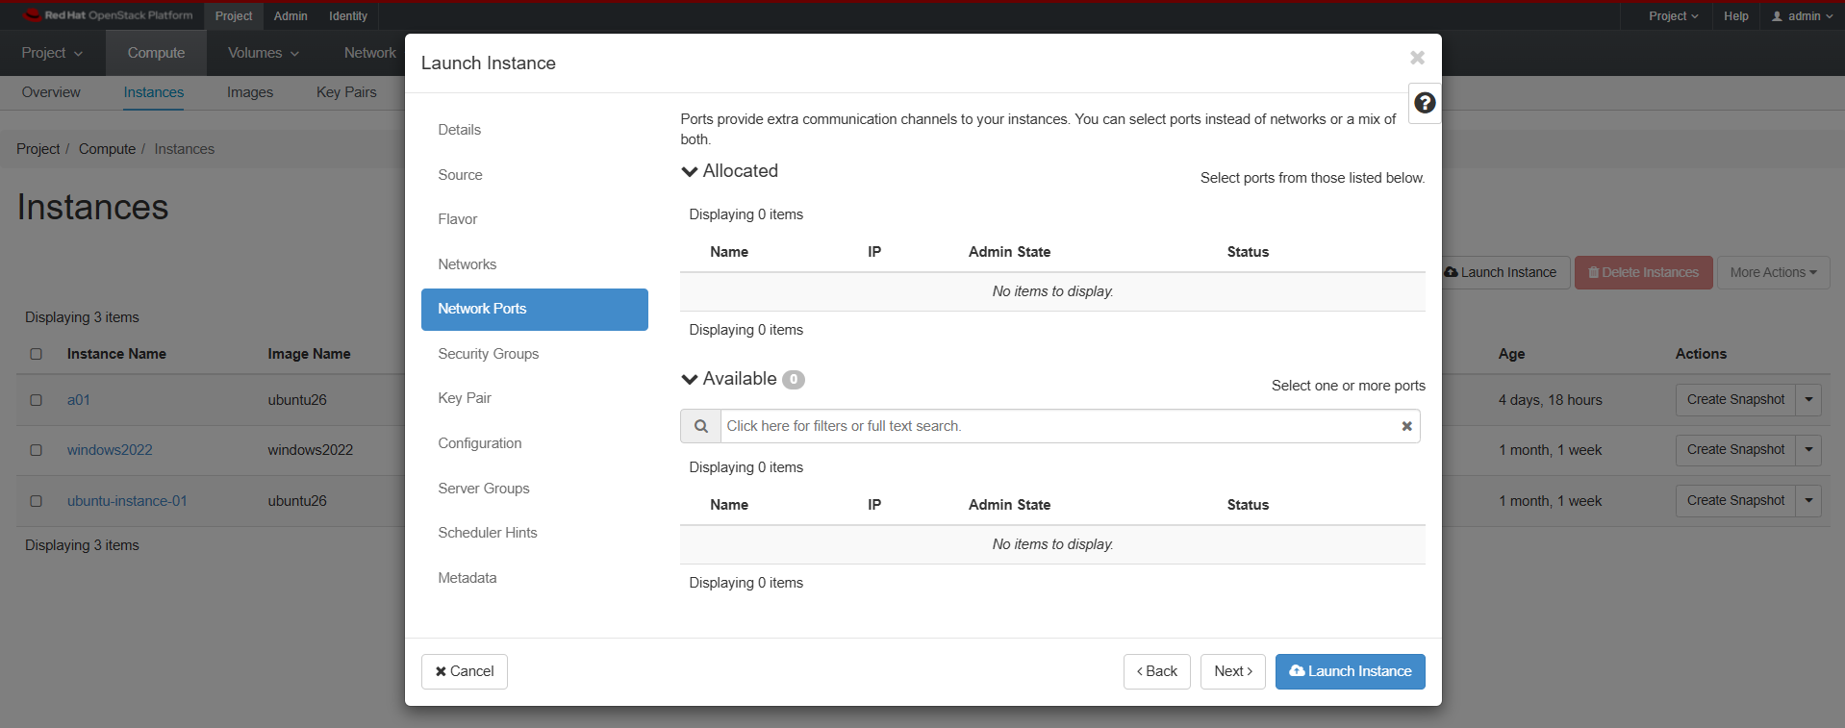
Instances

Slide 11
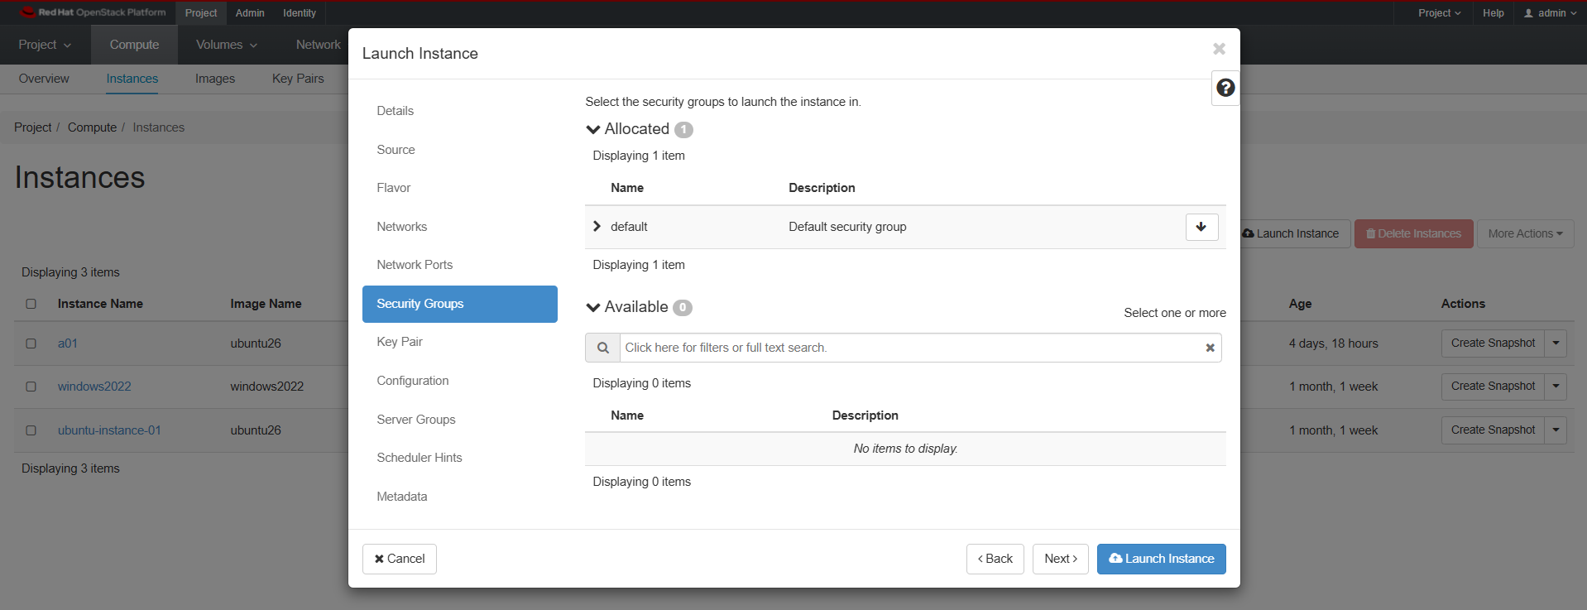
Instances

Slide 12
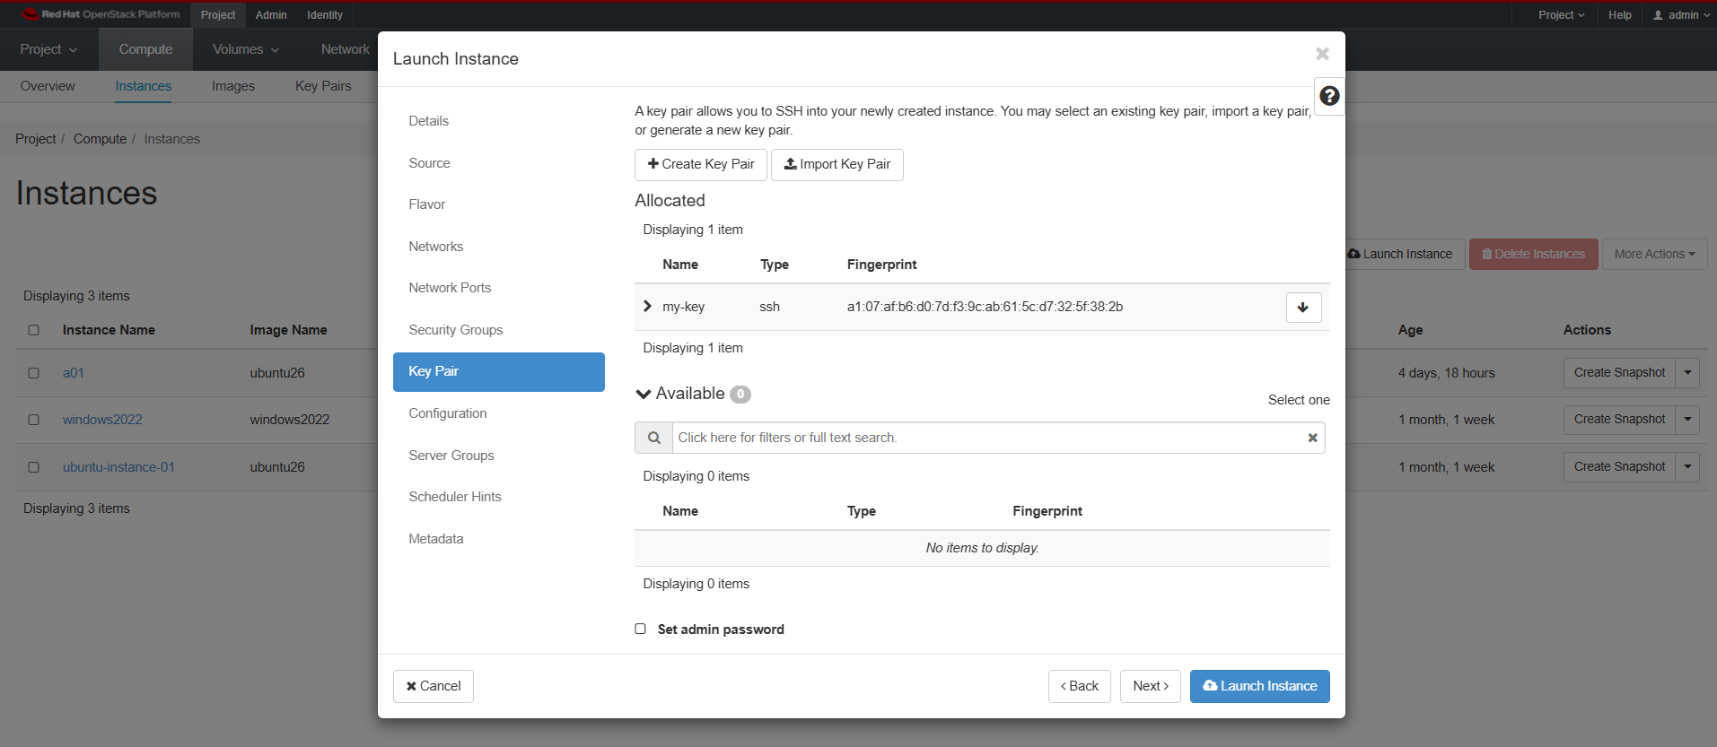
Instances

Slide 13
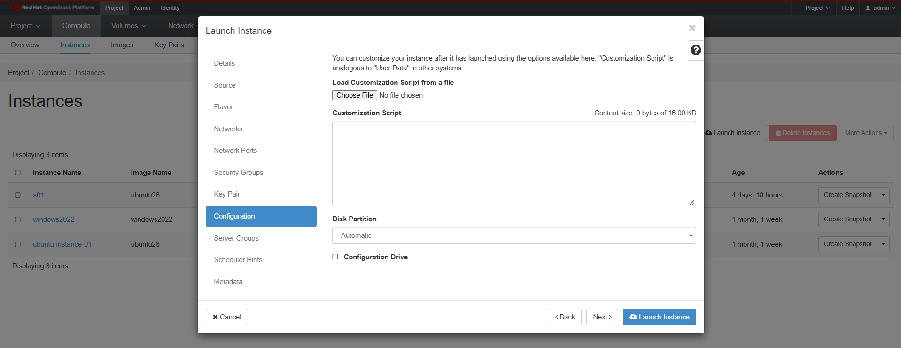
Instances

Slide 14
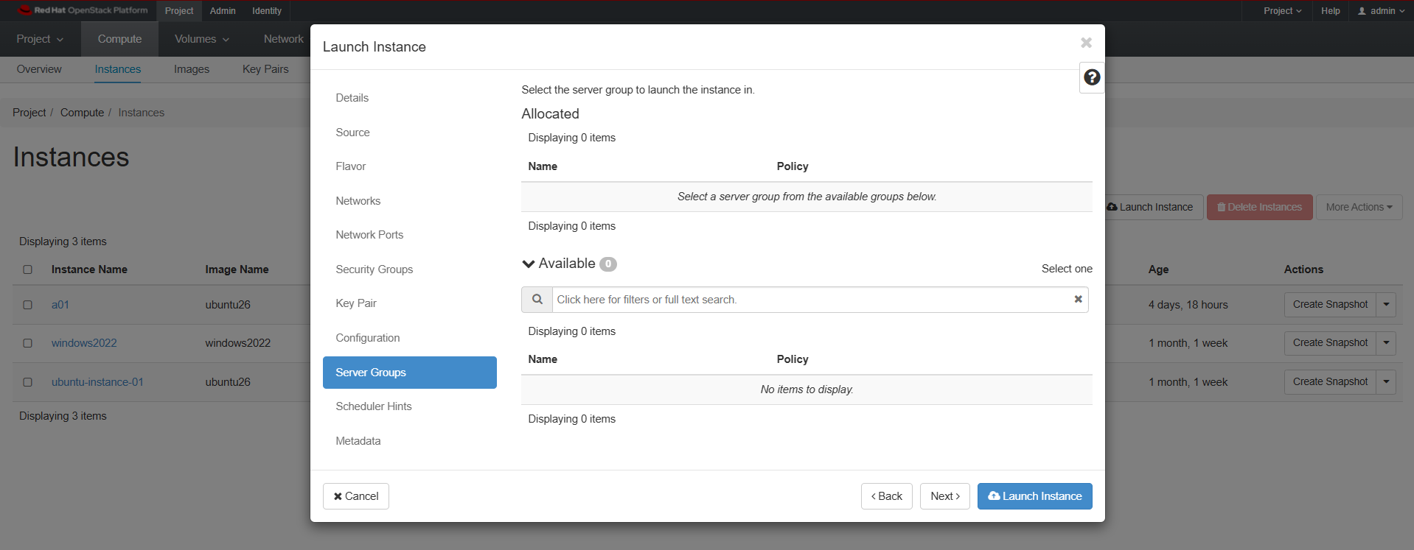
Instances

Slide 15
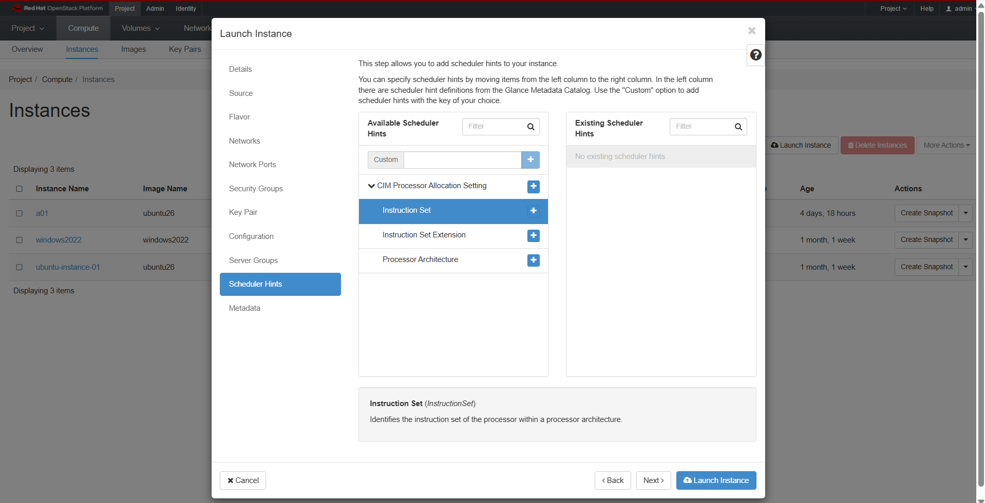
Instances

Slide 16
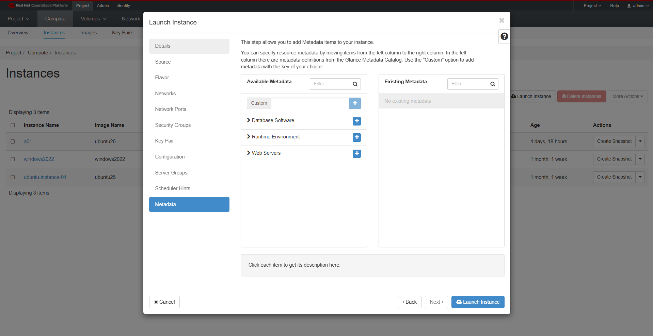
Instances

Slide 17
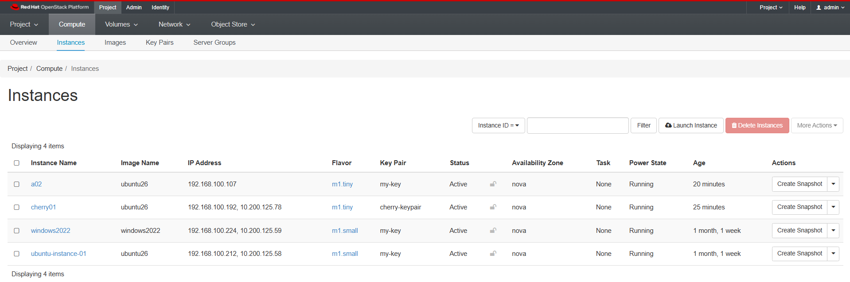
Instances

Slide 18
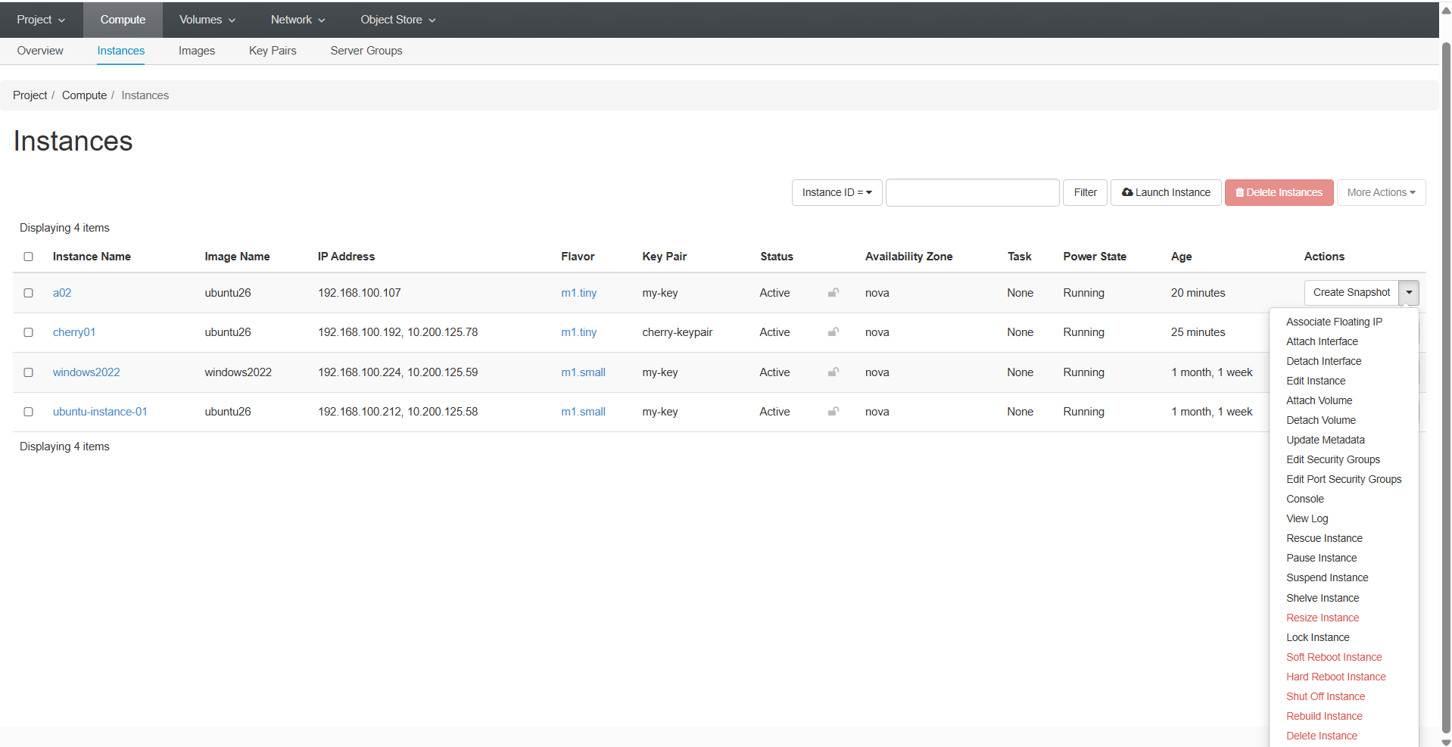
Instances

Slide 19
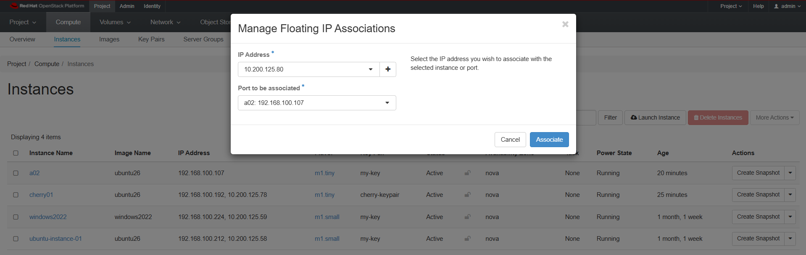
Associate Floating IP

Slide 20
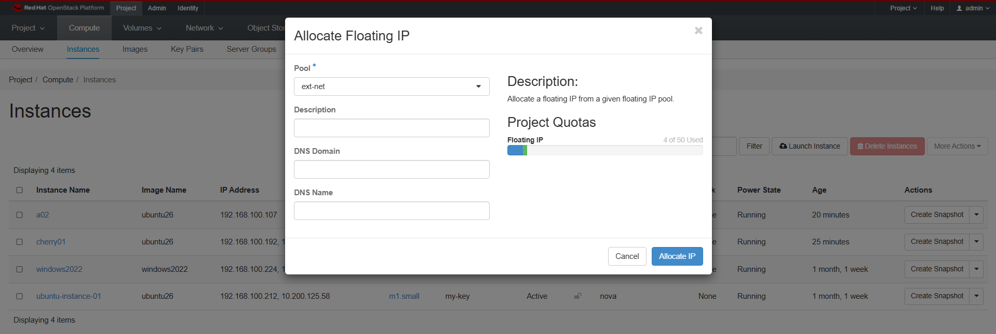
Allocate IP

Slide 21
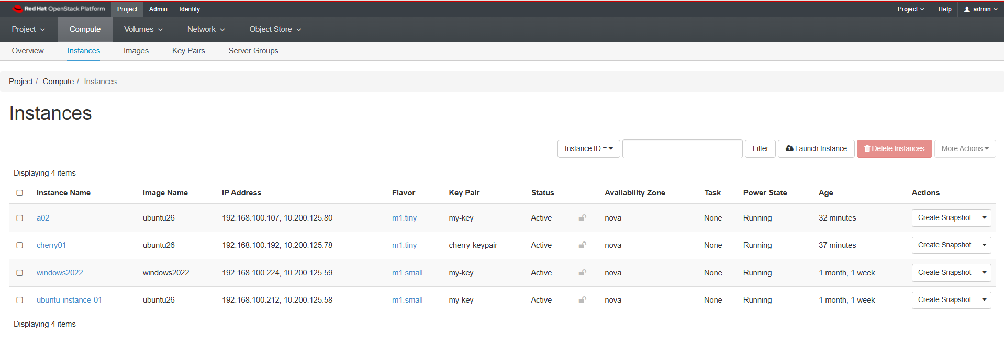
Allocate IP

Slide 22
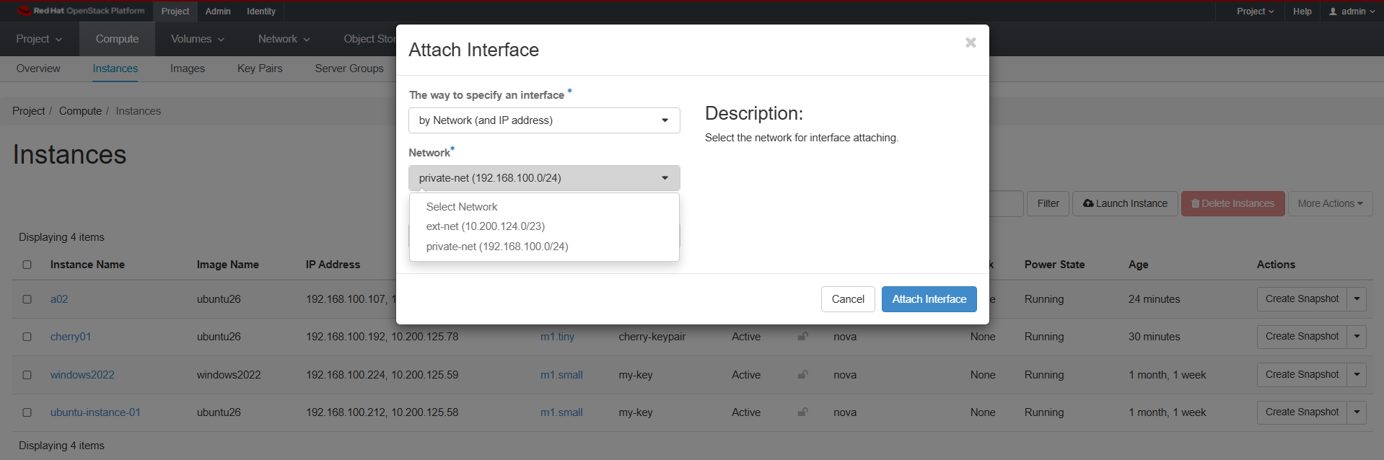
Attach Interface

Slide 23
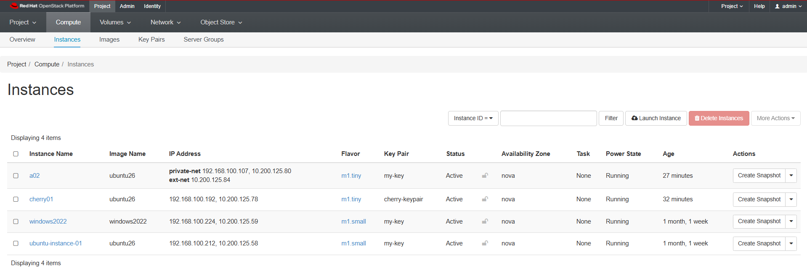
Attach Interface

Slide 24
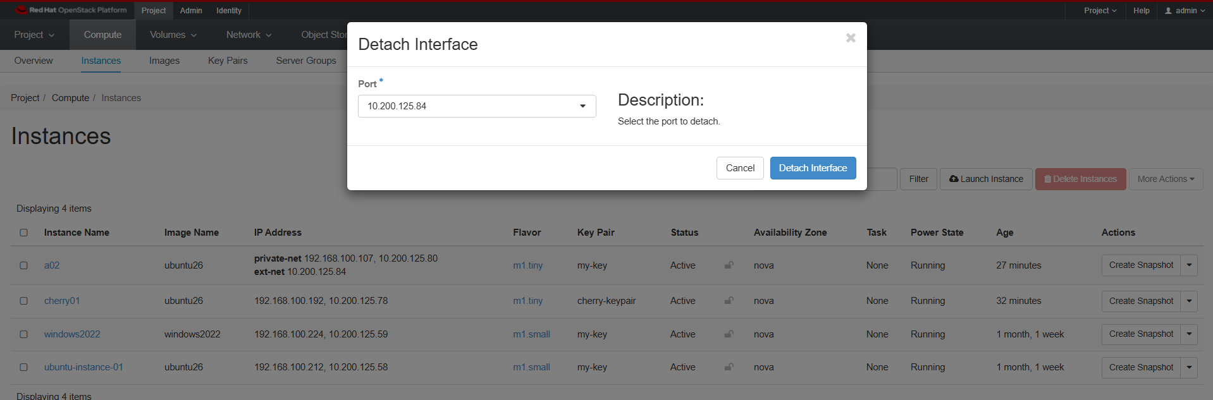
Detach Interface

Slide 25
Detach Interface

Slide 26
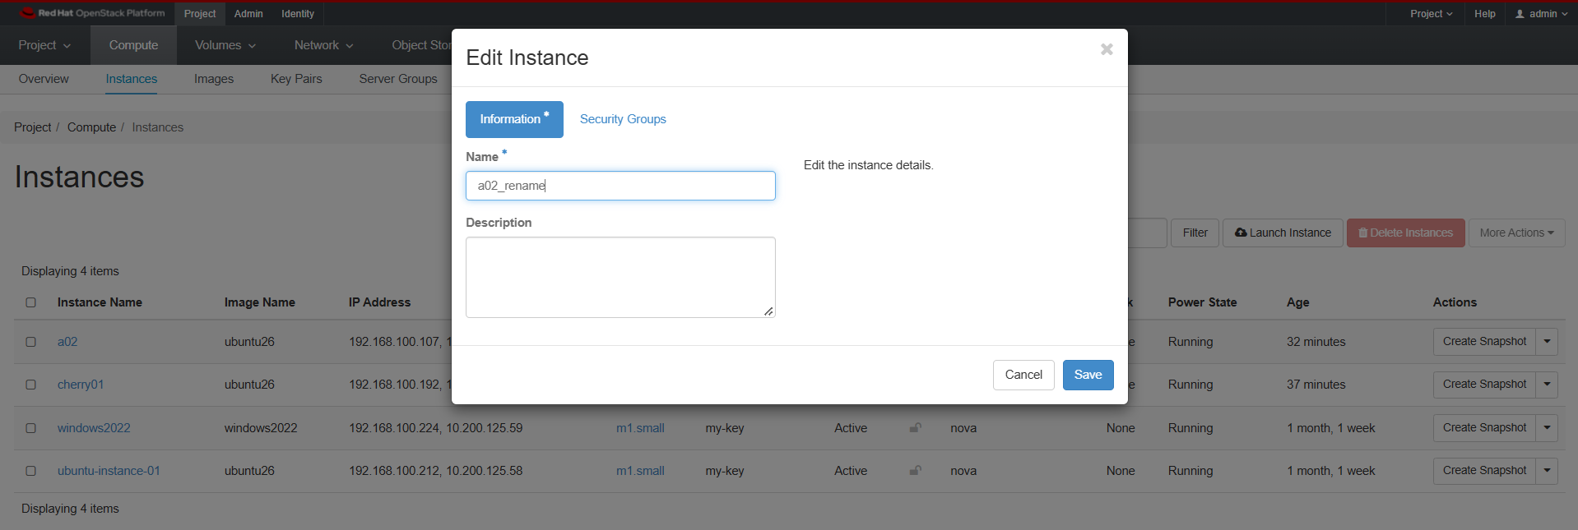
Edit Instance

Slide 27
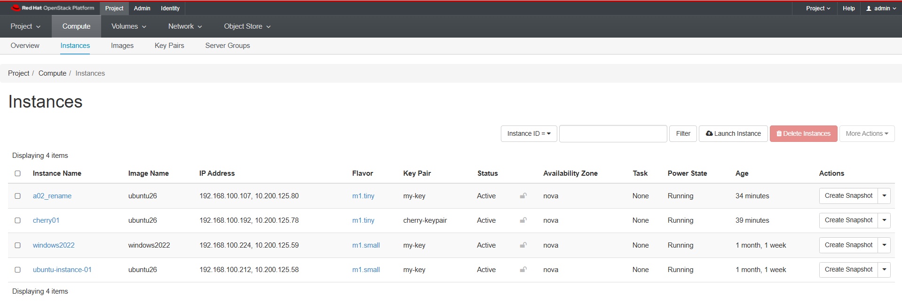
Edit Instance
Edit Instance

Slide 28
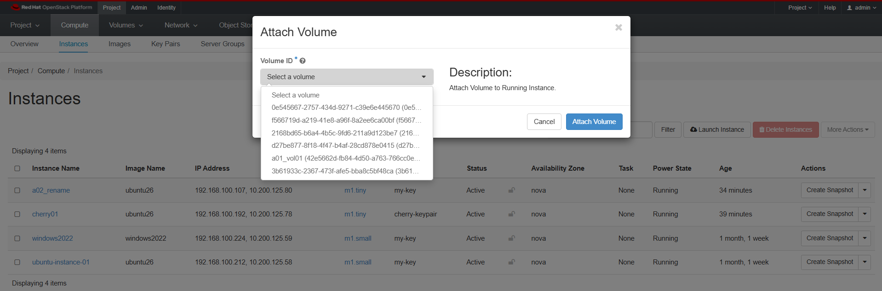
Attach Volume

Slide 29
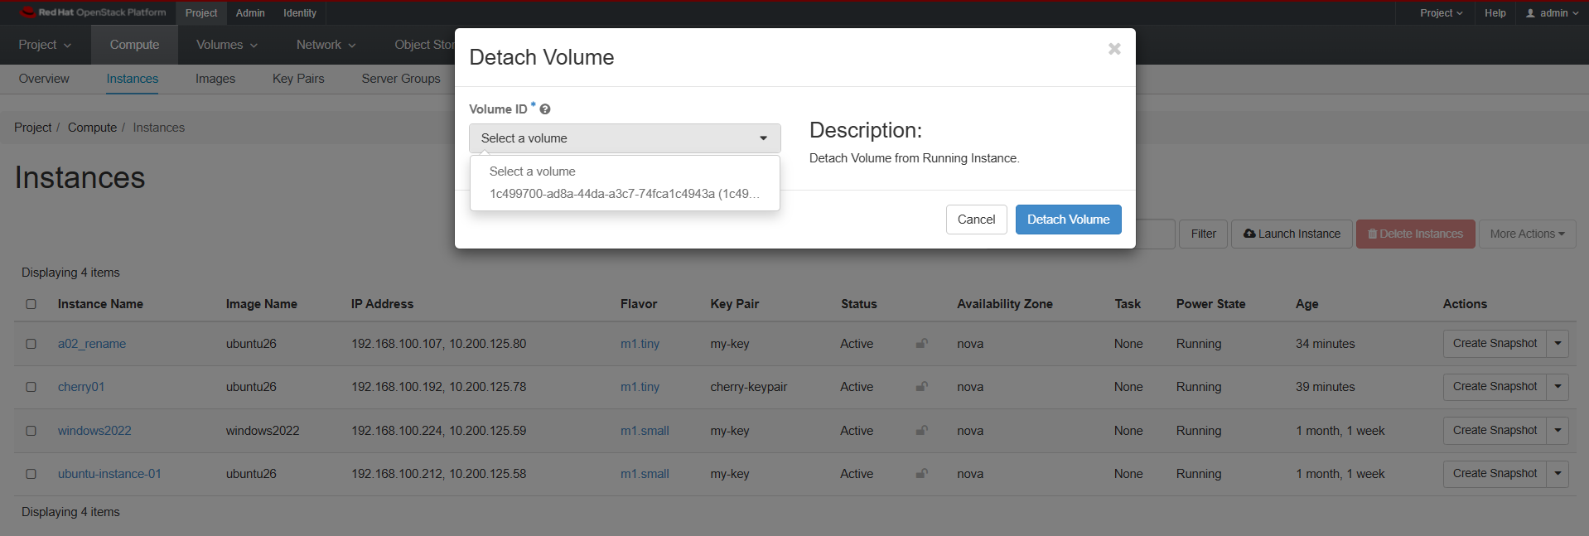
Detach Volume

Slide 30
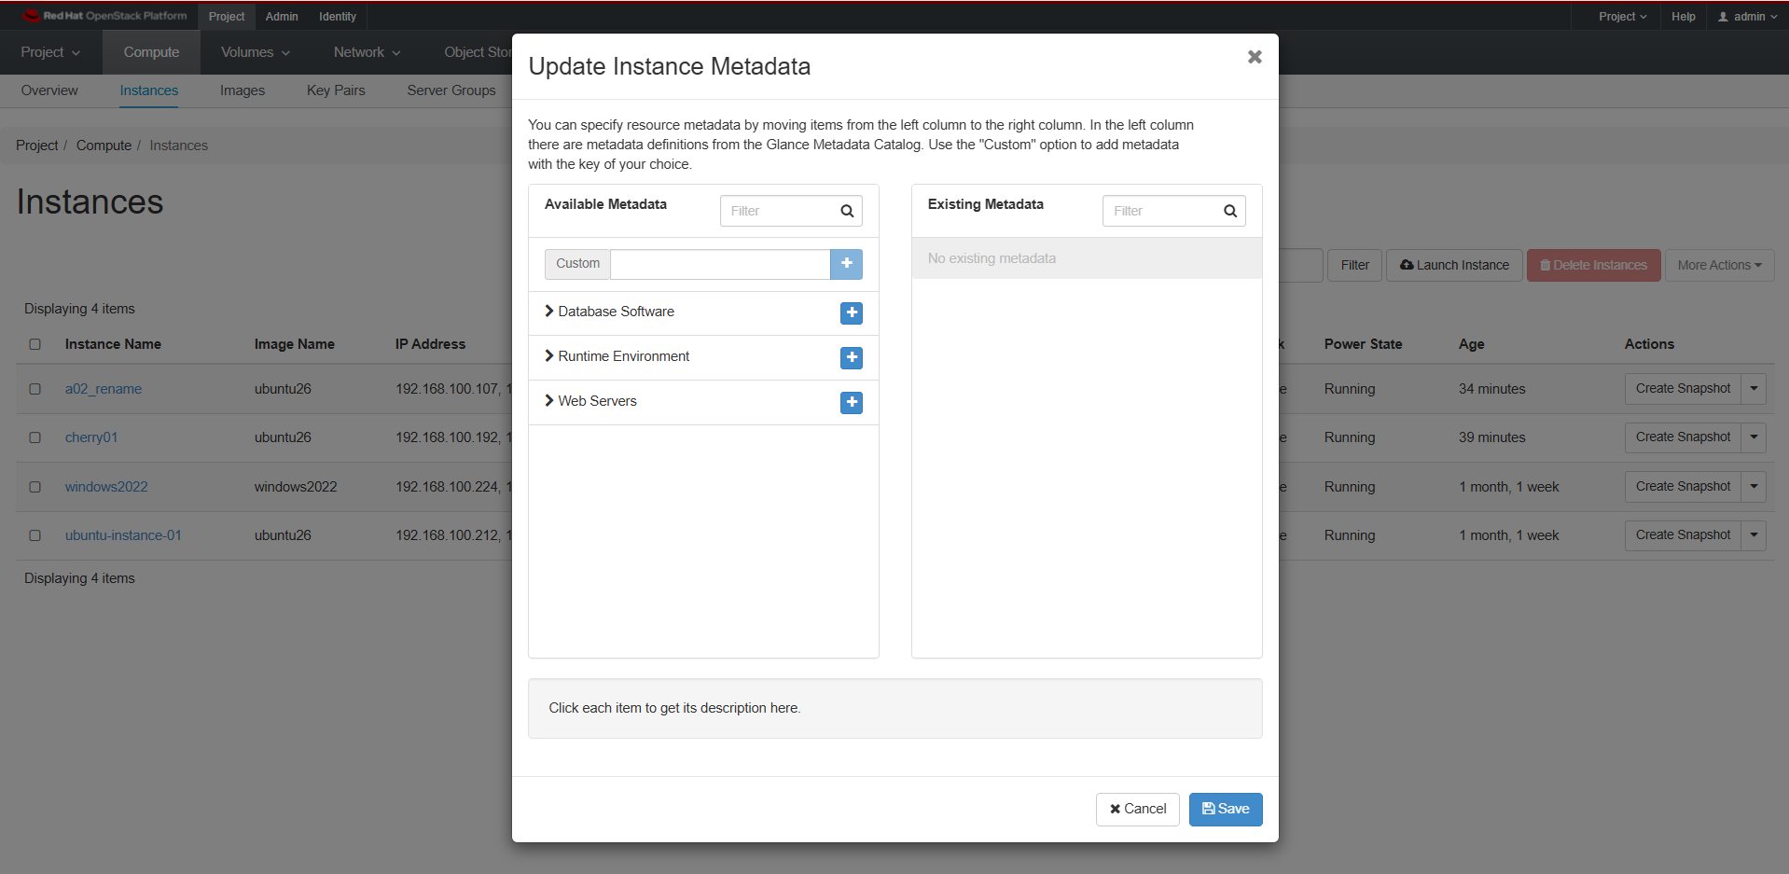
Update Instance Metadata

Slide 31
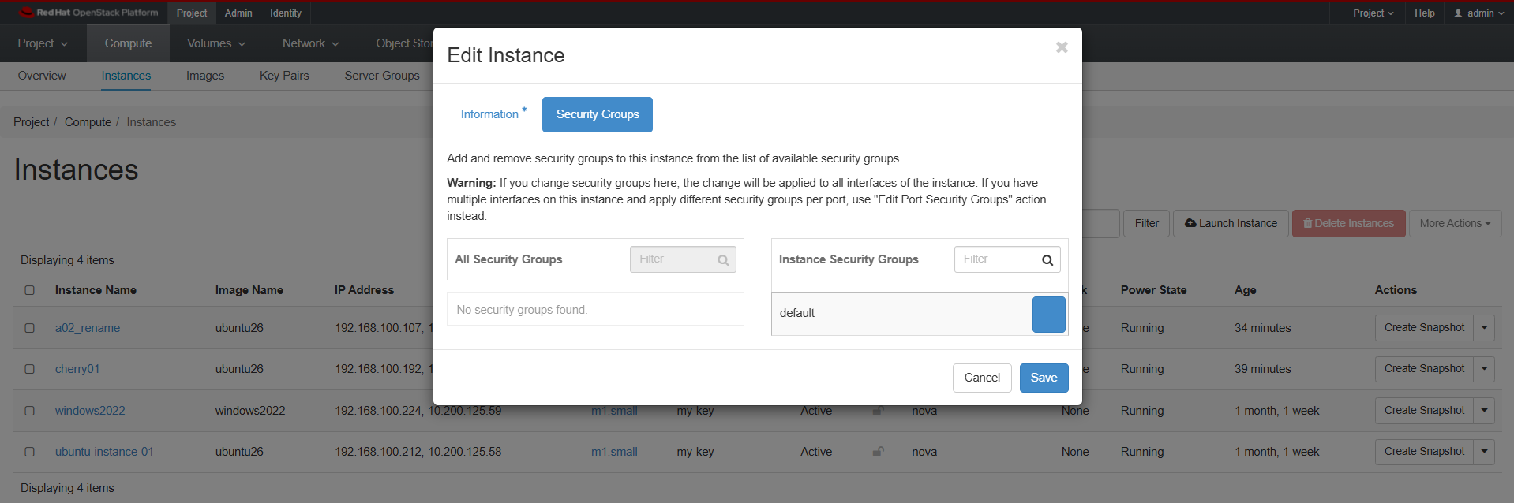
Edit Security Groups

Slide 32
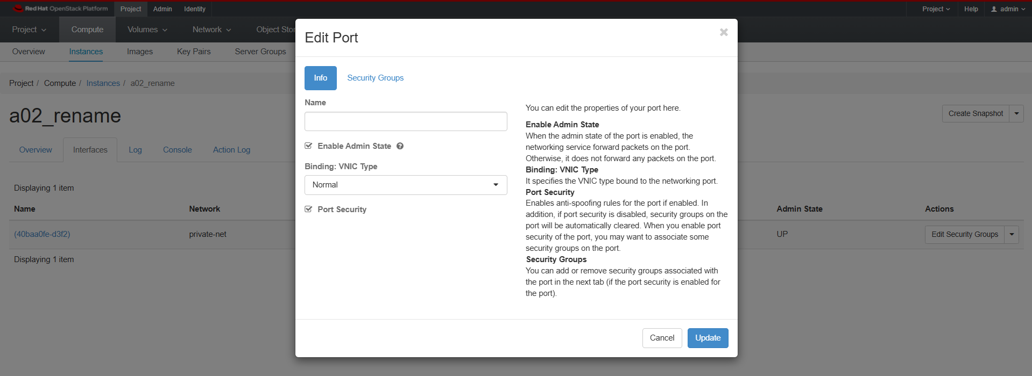
Edit Port Security Groups

Slide 33
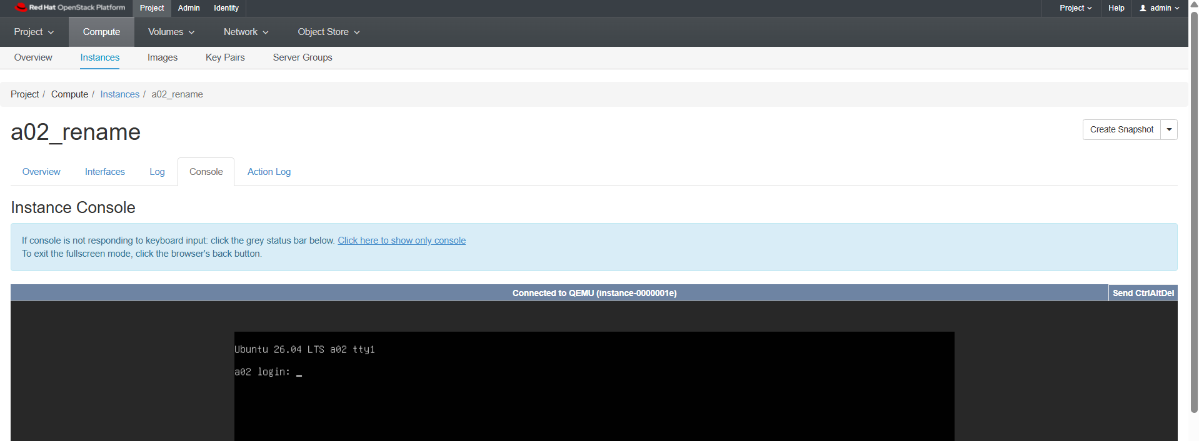
Console

Slide 34
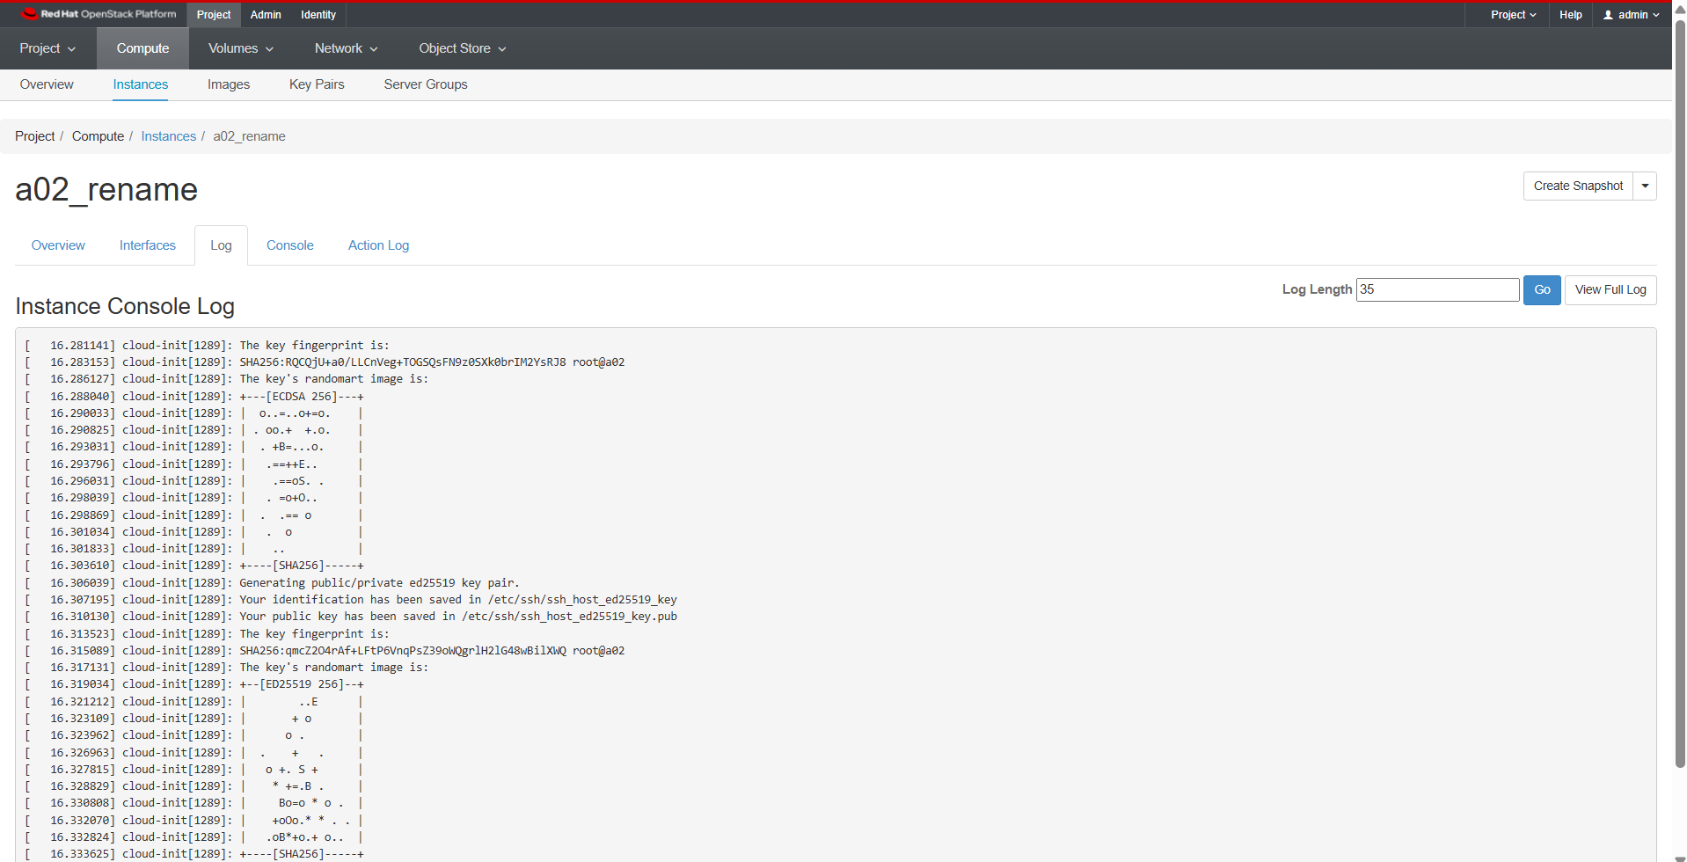
View Log

Slide 35
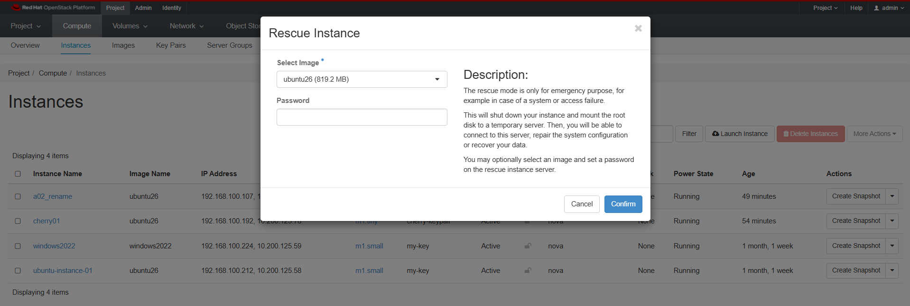
Rescue Instance

Slide 36

Pause Instance

Slide 37
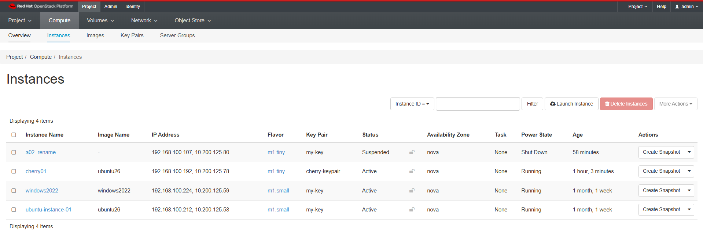
Suspend Instance

Slide 38
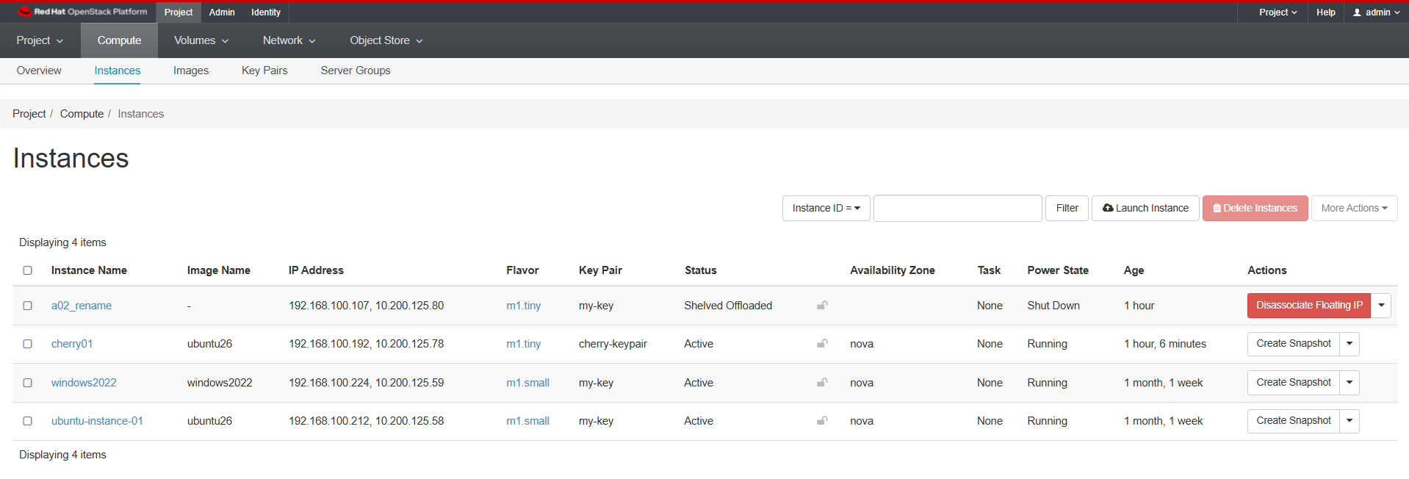
Shelve Instance

Slide 39
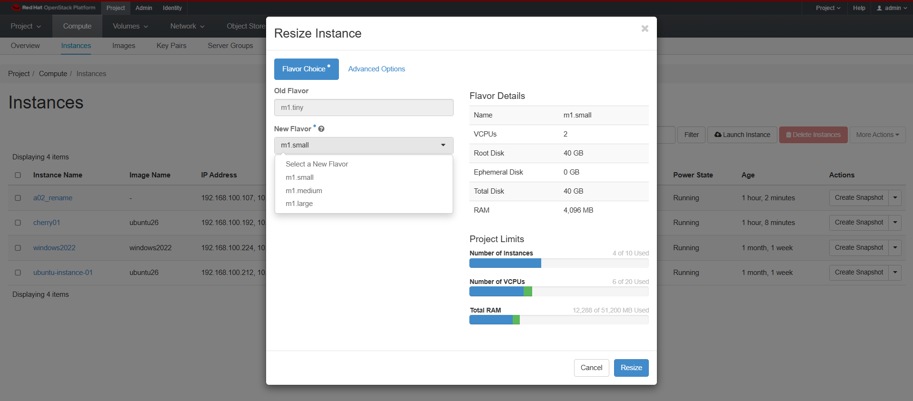
Resize Instance

Slide 40
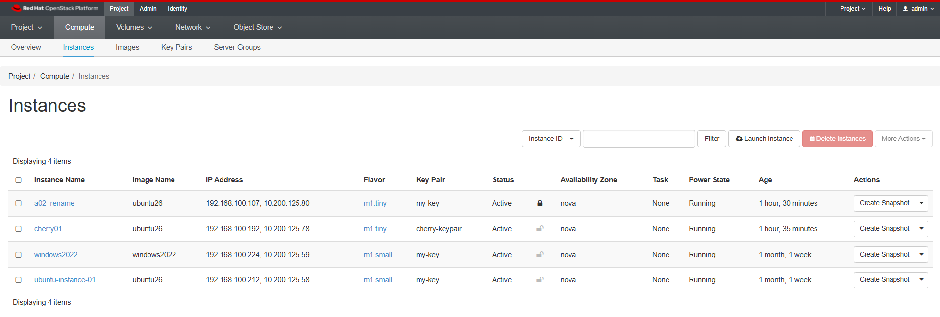
Lock Instance

Slide 41
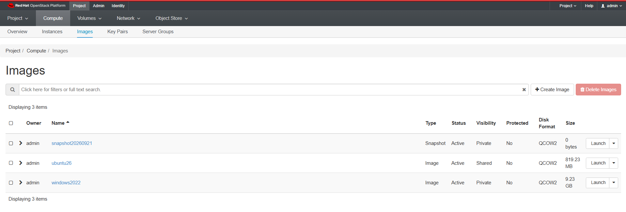
Image

Slide 42
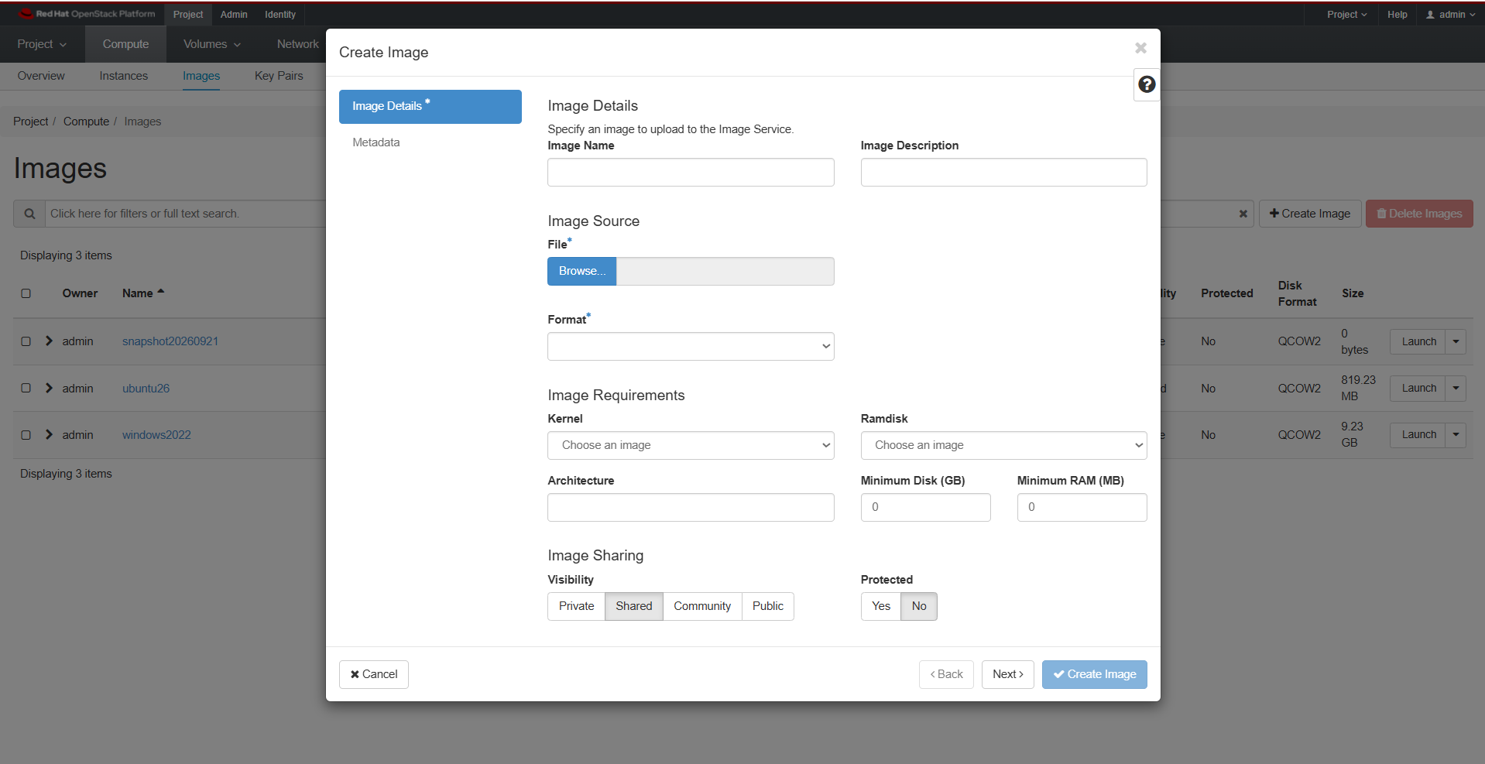
Create Image

Slide 43
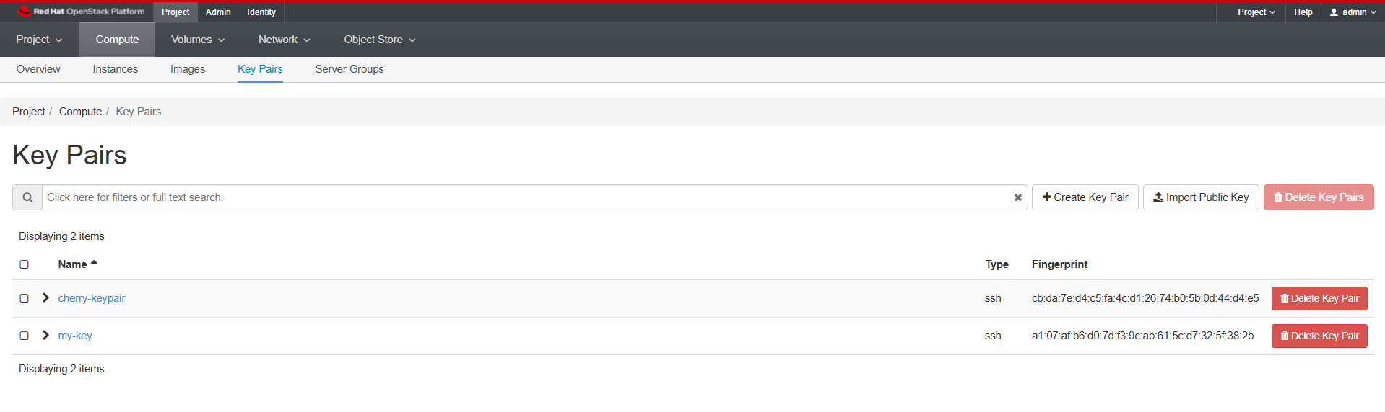
Key pairs

Slide 44
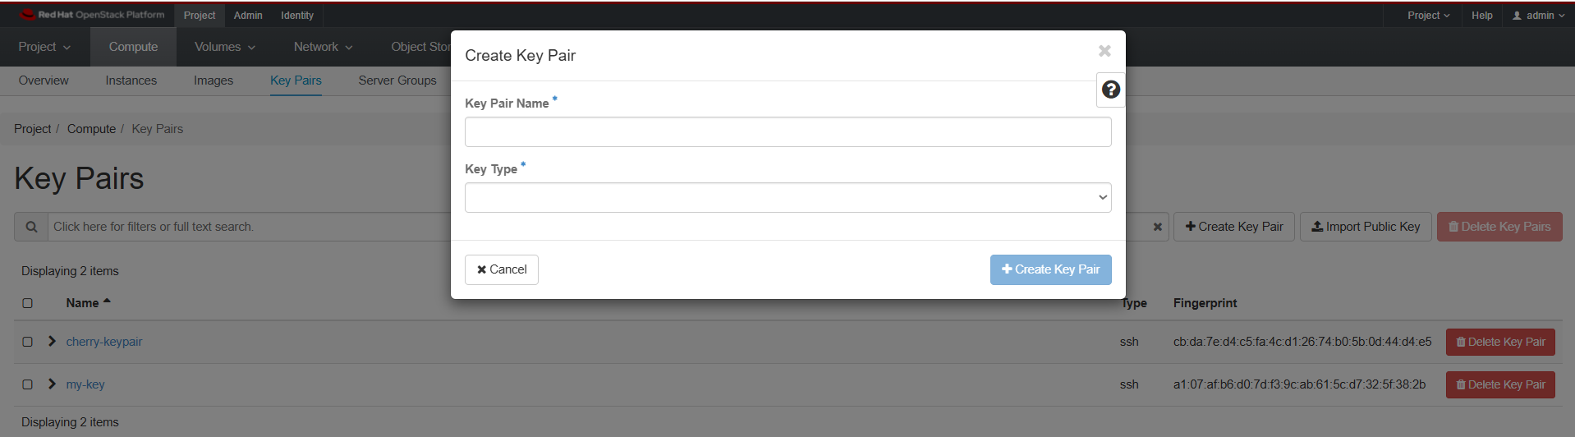
Create Key Pair

Slide 45
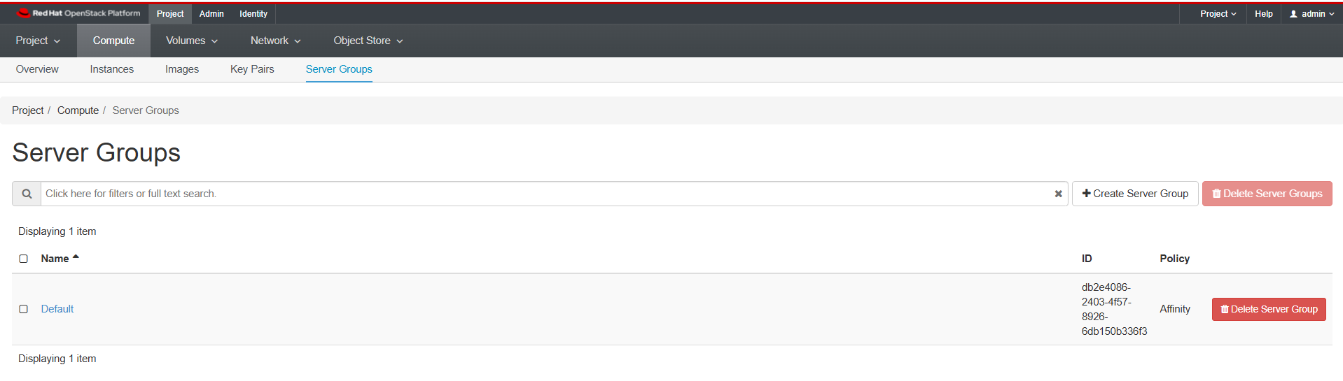
Server Groups

Slide 46
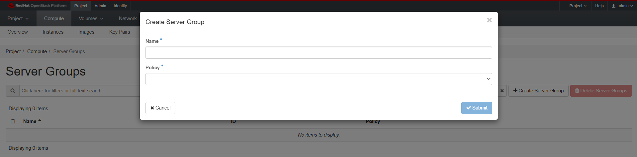
Create Server Group

Slide 47
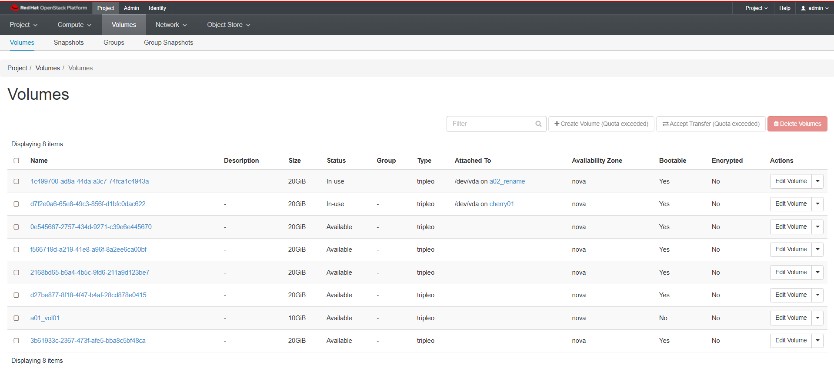
Volumes

Slide 48
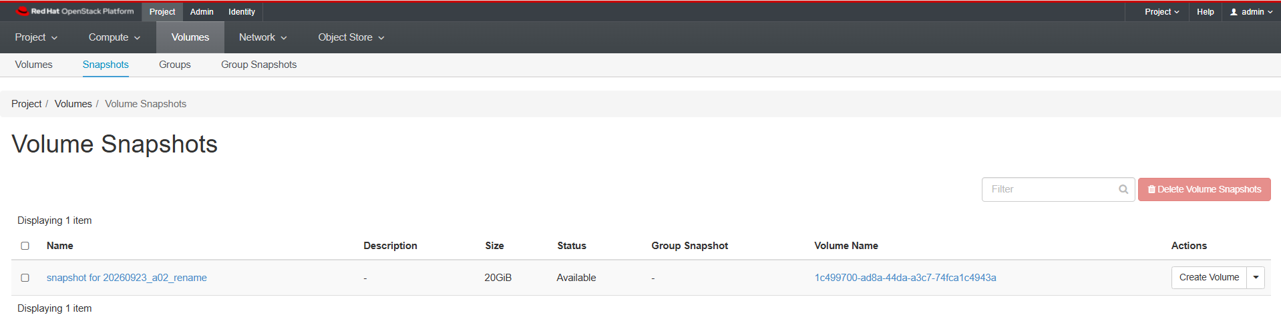
Snapshots

Slide 49
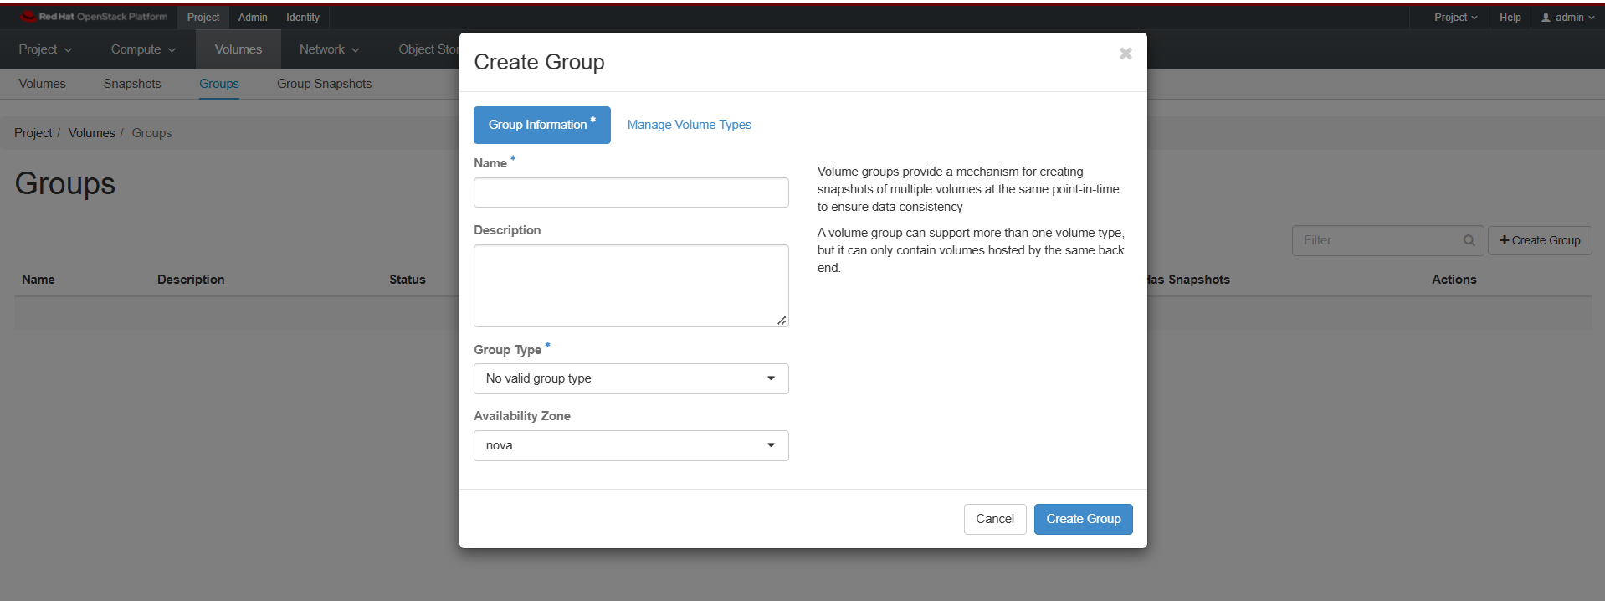
Groups

Slide 50
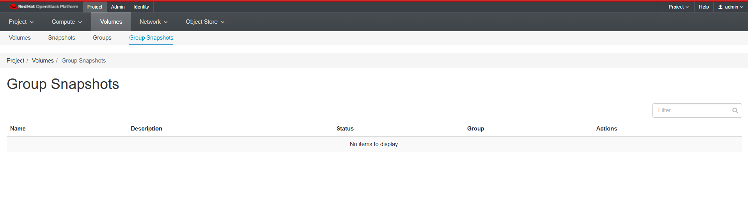
Group Snapshots

Slide 51
Network

Slide 52
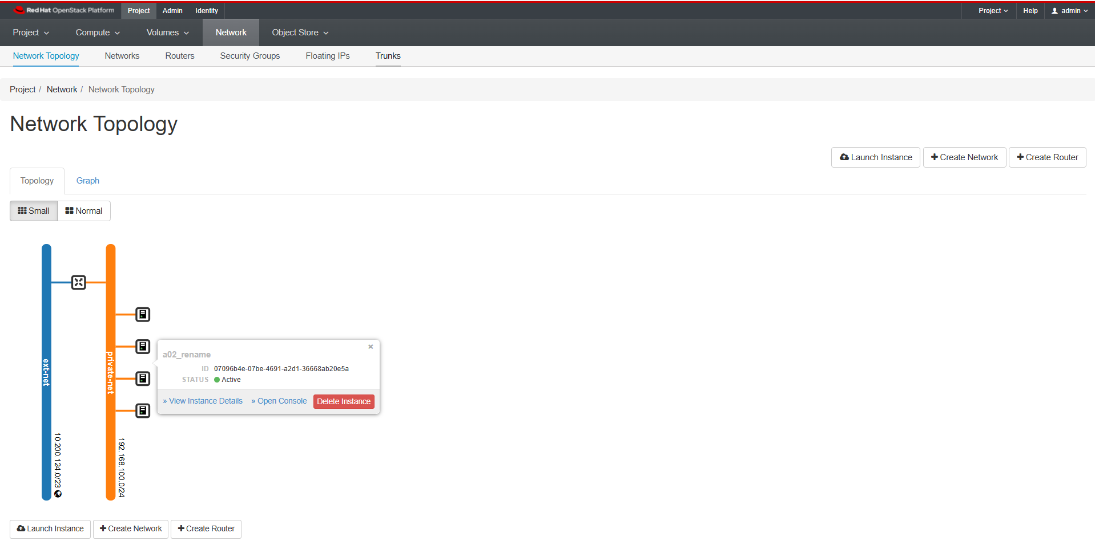
Network Topology

Slide 53
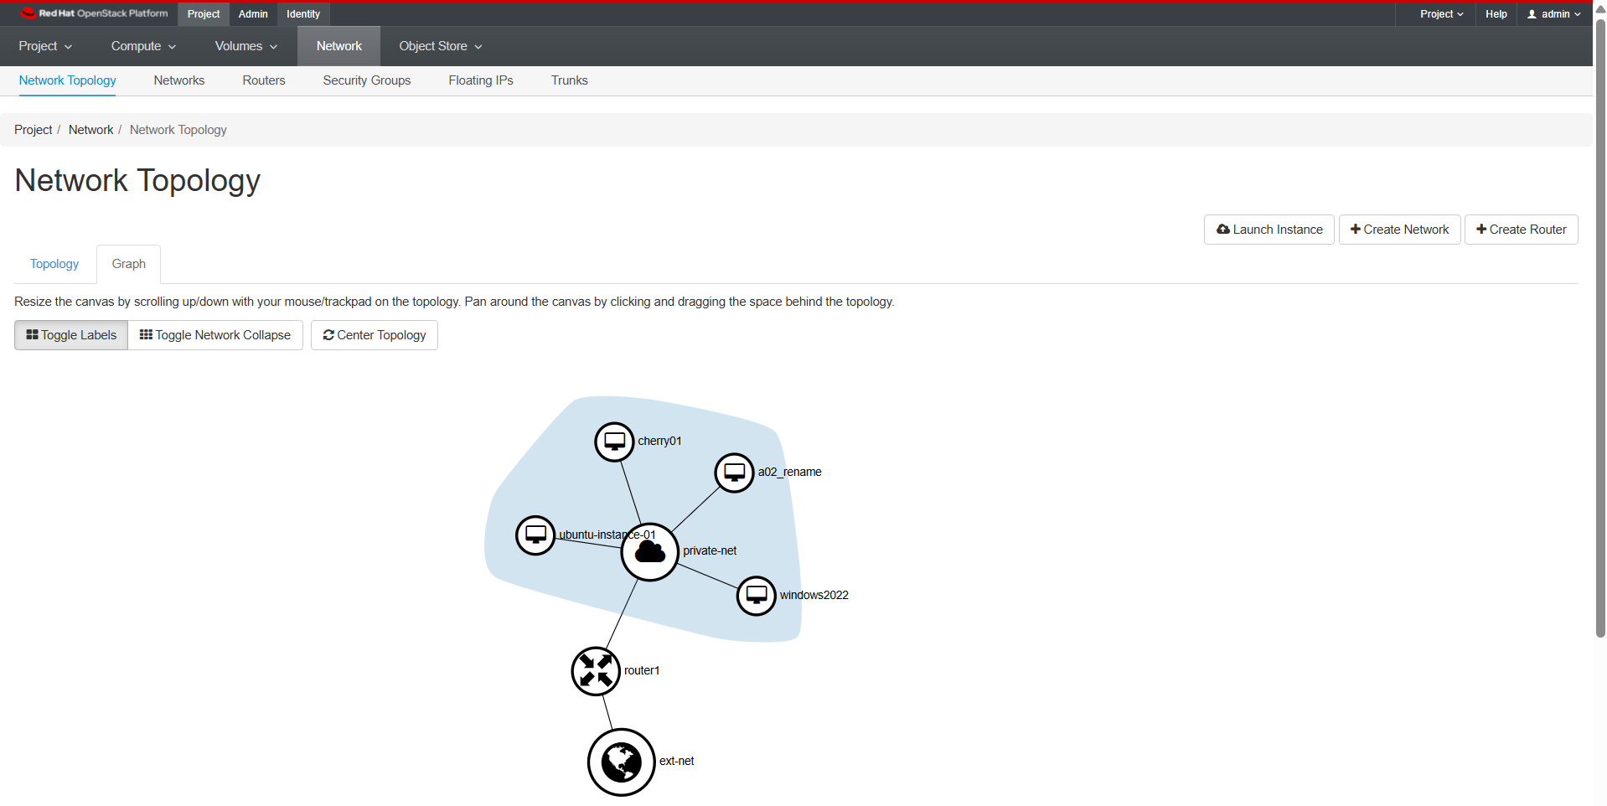
Network Topology

Slide 54
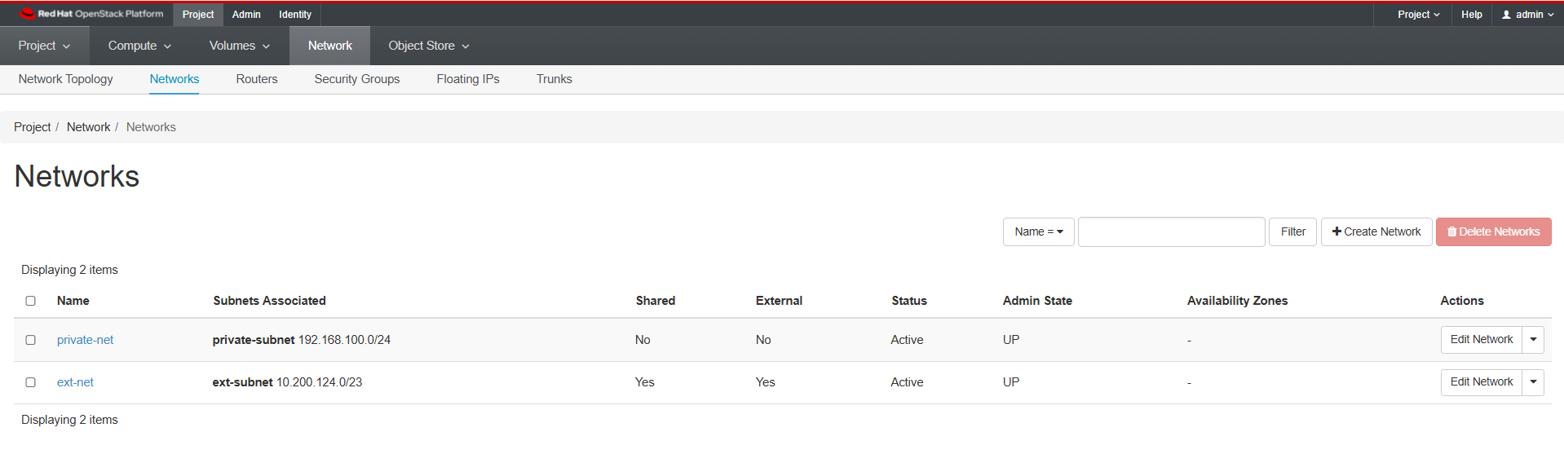
Networks

Slide 55
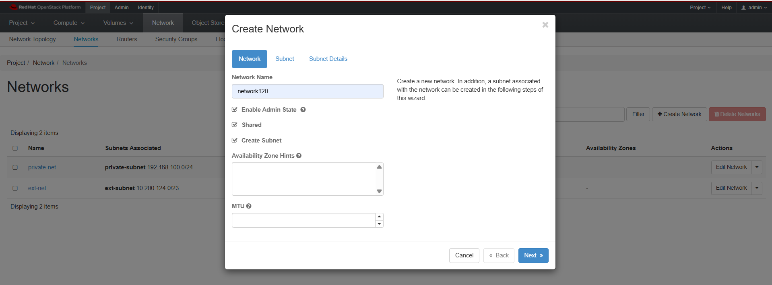
Create Network

Slide 56

Create Network

Slide 57

Create Network

Slide 58

Create Network

Slide 59

Routers

Slide 60

Routers

Slide 61

Routers

Slide 62

Routers

Slide 63

Security Groups

Slide 64

Manage Rules

Slide 65

Floating IPs

Slide 66

Trunks

Slide 67

Object Store

